Slide 1
Get Covered Illinois Broker Webinar
Thursday, August 20, 2026
11:00 AM CT

Slide 2
Logistics
Phone lines are muted upon entry. ​
To submit comments or questions, click the icon with three dots at the bottom right of your screen, then select the “Q&A” option. ​
  Questions are encouraged!
We will address technical questions about the webinar and recording as they come in.
The slides and recording will soon be available on the Get Covered Illinois website!

Slide 3
Agenda
Important Updates
Paying Back Advance Premium Tax Credits (APTCs)
HR1 Information
Broker Newsletter
Q&A Session

Slide 4
Important Updates

Slide 5

Open Enrollment Plan Year 2027
No change for the upcoming Open Enrollment
November 1, 2026 - January 15, 2027
Enroll by December 15 for coverage beginning January 1

Slide 6
Extended Hours Pilot
We are launching an extended hours pilot program to evaluate customer adoption, operational impact and overall effectiveness of extended hours outside of open enrollment.
Core hours: Monday thru Friday, 8 a.m. – 6 p.m.
Extended hours: Monday thru Friday, 6 p.m. – 10 p.m.

Slide 7
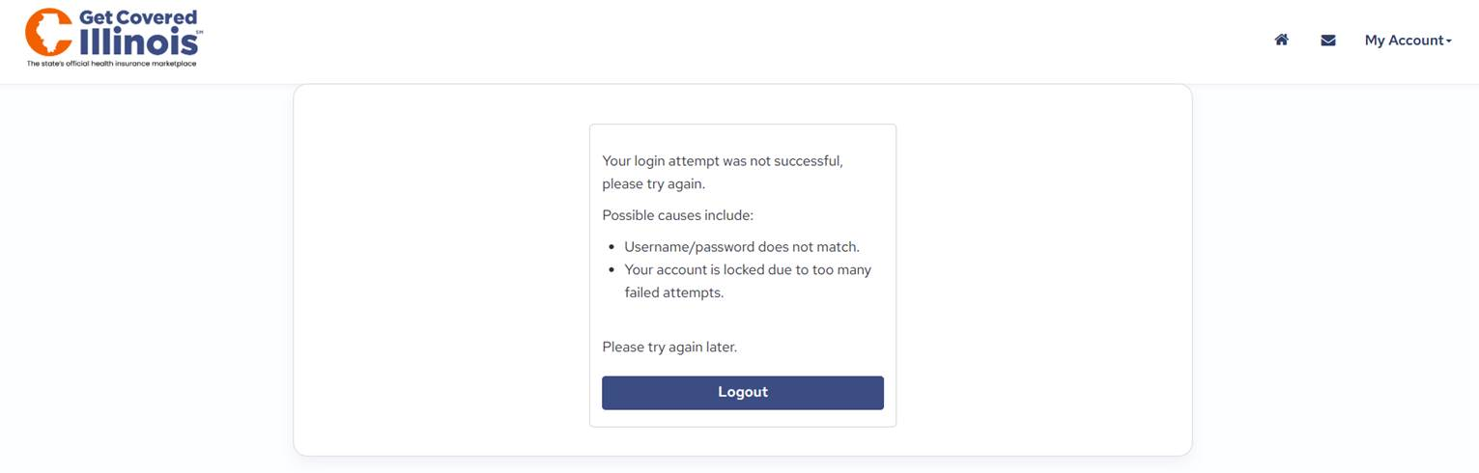
Broker Account Inactivity: IMPORTANT
Login credentials for Broker Portal accounts will be locked after 60 days of inactivity (i.e., not logging in) due to privacy and security reasons.
To unlock your account:
  Call the Get Covered Illinois Assister & Broker Support Team (1-866-349-7579) to verify your identity and reactivate your Broker Portal account.
  Update your Broker Portal password.
  Log into your account regularly to prevent future lockouts.

Slide 8
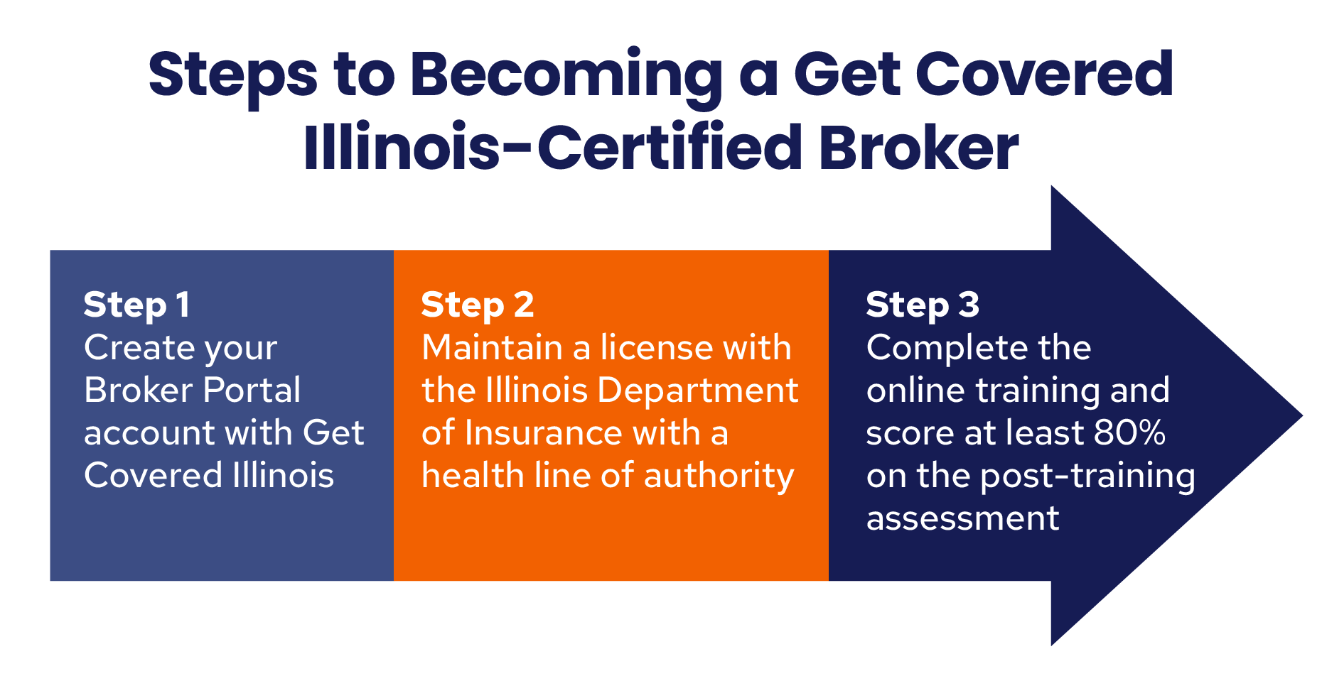

Slide 9

Broker Certification Training
The Get Covered Illinois 2027 certification under maintenance until August 24, 2026.
We are aware of some unexpected display errors affecting the knowledge checks. To address these issues, the training system will be taken offline for maintenance on Monday, August 24, 2026.

Slide 10
Things to Know
You must be pre-registered for the training. Do not share or follow a shared link, this will delay your registration.
Brokers with an active account on Get Covered Illinois will be sent a new email early next week. Please check your spam.
If you are new or have new brokers that need to be registered, please contact GCI.Outreach@illinois.gov.
There are knowledge checks with each unit that are not scored as a part of the 80% test requirements.
The final exam is 25 questions, and you must score 80% or higher to continue to the attestations.

Slide 11
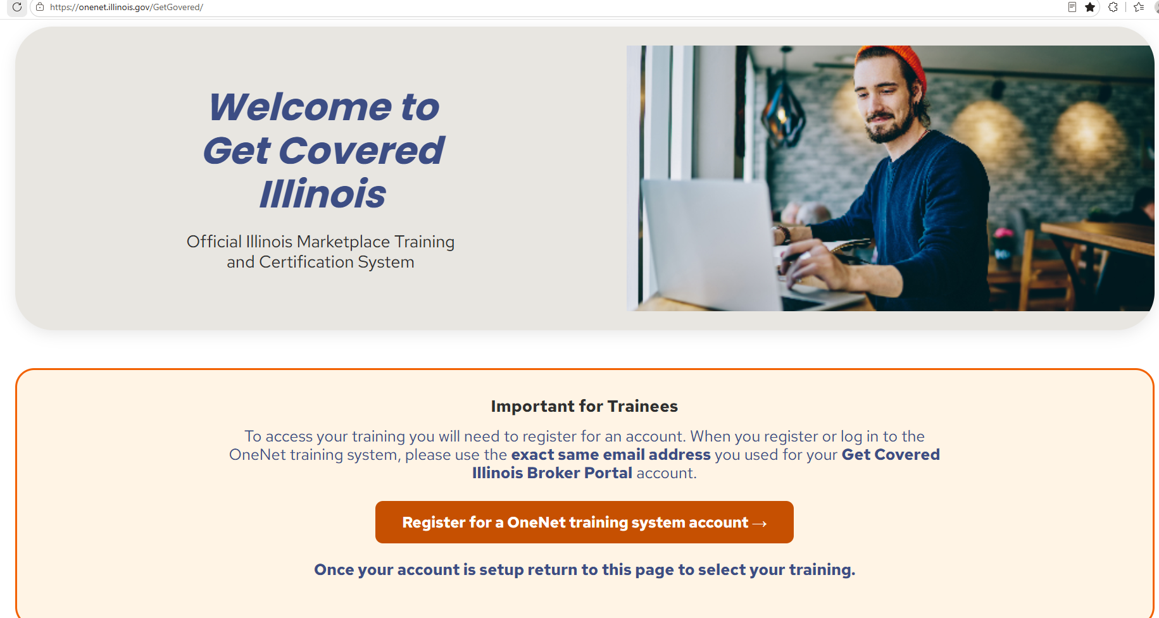
Step One: Register for a OneNet Training Account

Slide 12
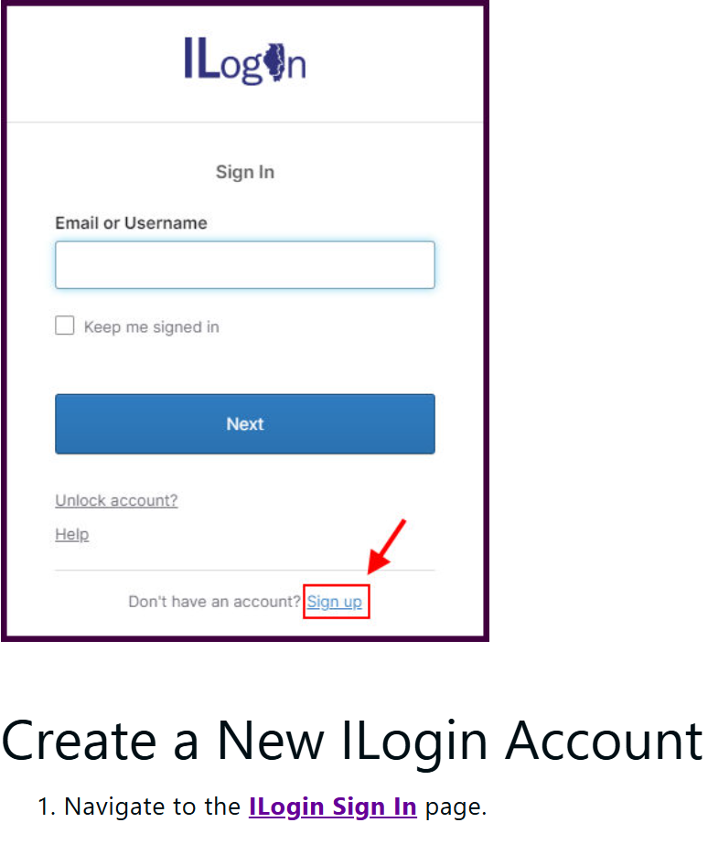
Step Two: ILogin
Navigate to the ILogin Sign In page.
Click Sign up.
Complete all required fields. Complete optional fields, as needed.
Click Sign Up.
On the Set up security methods menu, under the Email or phone option, click Set up.
The confirmation page appears telling the user to check their email. Note: This activation link is valid for 30 minutes and then these steps are required to be restarted.

Slide 13

Step Three:
Important Step.
Select the Agent/Broker Marketplace Certification Training Learning Path
Click Here

Slide 14

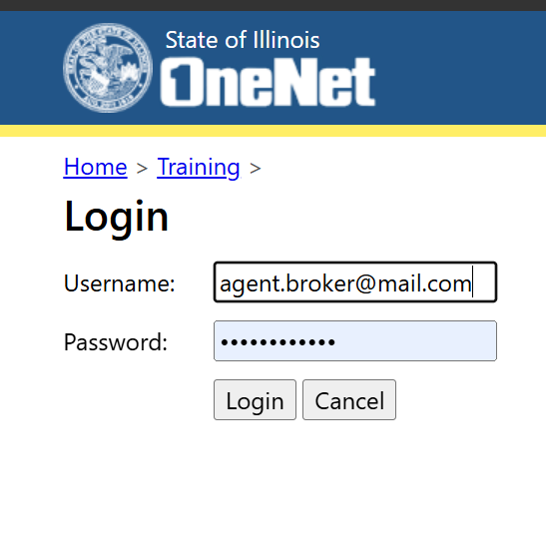
Step Four:
Select "Start Training"
Enter your Username and Password​

Slide 15
Reconciling Premium Tax Credits

Slide 16

Premium Tax Credit When Income Falls Below 100% FPL
Beginning with Plan Year 2026, customers must repay all excess APTC if they received more advance payments than they were eligible for.​
Customers who estimated their household income at or above 100% of the Federal Poverty Level (FPL) and received Advance Premium Tax Credits (APTCs) may still qualify for the Premium Tax Credit (PTC) when filing their federal tax return, even if their actual household income is below 100% FPL.​
This applies only if the customer did not intentionally or recklessly misrepresent their household income when applying for coverage.
A customer's projected household income must be based on the most accurate information available at the time they apply. As a Get Covered Illinois certified broker or assister, it is your responsibility to educate customers about the risks of intentionally overstating their income to qualify for Premium Tax Credits (PTCs) or avoid a Medicaid eligibility determination. If a customer intentionally or recklessly misrepresents their household income, the IRS may deny their Premium Tax Credit, and the customer may be required to repay any Advance Premium Tax Credits (APTCs) they were not eligible to receive.

Slide 17
What Is "Intentional or Reckless" Misrepresentation?
The IRS may deny the Premium Tax Credit if a customer:
Knowingly provides false income information.
Makes little or no effort to provide accurate income information.
Acts in a way that differs significantly from what a reasonable person would do to estimate household income.
As a Get Covered Illinois broker or assister it is your responsibility to help customers provide an accurate, good-faith estimate of their expected household income. Estimating income honestly protects both the customer and your professional integrity. Intentionally reporting inaccurate income to obtain financial assistance is not permitted and may have financial consequences for the customer and compliance consequences for the assister or broker.
If the customer reports an income change and they become eligible for PTC; the income will rebalance. The rebalancing could impact the amount of repayment, depending on their final annual income and the total PTC received.

Slide 18
Annual Premium Tax Credit (PTC) Reconciliation
Customers who receive financial assistance through Get Covered Illinois must reconcile the Advance Premium Tax Credits they received during the year with the Premium Tax Credit they were actually eligible for based on their final household income and family size.
After the end of the year, Get Covered Illinois sends IRS Form 1095-A to both the customer and the IRS. This form includes the information needed to complete IRS Form 8962, which is filed with the customer's federal tax return to reconcile APTC.
If corrected information becomes available after Form 1095-A is issued, Get Covered Illinois will issue a corrected or voided form.
Reconciliation compares:
APTC received during the year
Final Premium Tax Credit (PTC) based on actual household income and family size.
Get Covered Illinois issues Form 1095-A each year.
Customers use Form 1095-A to complete Form 8962 when filing their federal tax return.

Slide 19
Reconciliation Outcomes and Repayment
Advance Premium Tax Credits are based on a customer's projected income at the time they enroll. When taxes are filed, the IRS compares that estimate with the customer's actual household income and family size to determine the final Premium Tax Credit amount.
If the customer received too much APTC, the excess must be repaid. If they received too little, they may receive the remaining credit when filing their federal income tax return.
For tax year 2026 and later, repayment limits no longer apply. Customers are responsible for repaying the full amount of any excess Advance Premium Tax Credits they received.
After reconciliation, one of three outcomes will occur:
Received the correct amount of APTC: No additional action is required.
Received more APTC than eligible for: The excess APTC must be repaid.
Received less APTC than eligible for: The remaining Premium Tax Credit may be received as part of the federal tax refund.
  Beginning with Tax Year 2026
Repayment caps for excess APTC have been eliminated.
Households must repay the full amount of any excess APTC received.

Slide 20
Failure to File and Reconcile
Get Covered Illinois enrollees who receive APTC are required under federal law to file their federal taxes and reconcile the APTC they received for any tax year in which they received it.
Federal rule finalized in June 2025 (90 FR 27074) requires that marketplaces determine applicants as APTC ineligible if IRS records indicate that they did not file and reconcile in a prior year in which they received APTC.
This process is known as the “failure to file and reconcile” or “FTR” process. In August 2025, a district court in the case of City of Columbus et al. v. Kennedy et al. stayed the FTR provision of the June 2025 rule and indicated that there was not a statutory basis for the conditioning of APTC eligibility upon prior tax reconciliation. HHS filed a notice of appeal in July.
As of August 2025, Get Covered Illinois has disabled the FTR process pending the resolution of the court case. This will be in place until PY2028.

Slide 21
H.R.1 Update

Slide 22
H.R.1
This legislation was signed into law in July 2025. It contains major overhauls to various public health programs, including the ACA and Medicaid. Our assessment of Marketplace impacts and implementation timeline include:
Effective 2026
  Eliminate caps on recapture of APTC.
  End PTC eligibility for immigrants with incomes up to 100% FPL subject to Medicaid waiting periods (5-year bar).
  Disallow PTC for income-based SEPs.
Effective 2027
  Narrow the categories of noncitizens eligible for PTC.
  Medicaid work requirements.
.
Effective 2028
  End automatic renewal of financial assistance.
  End eligibility for APTC pending veriﬁcation.
  Codify 1-year Failure to Reconcile (FTR) rule

Slide 23
Broker Newsletter

Slide 24

Get Covered Illinois
Broker Newsletter
Get Covered Illinois is excited to launch our inaugural quarterly broker newsletter. We want to guide, inform and celebrate our dedicated brokers.
From the Director’s Desk
  Message from Get Covered Illinois Leadership
News Roundup
  Updates on Recent Policy/Process Changes and their potential impacts to brokers and customers
Reminders (Upcoming)
  Certification Trainings
  Webinars/Office Hours
  In-Person Events
  Customer Assistance Phone Numbers and Closure Calendar
Broker Spotlight
  Janice Staab

Slide 25
Marketplace Triple Trivia Moment

Slide 26
After the end of the year, Get Covered Illinois sends the IRS Form 1095-A to:
A. To the customer only
B. To the IRS only
C. To both the customer and IRS
D. Get Covered Illinois does not send out the Form 1095-A
Question 1

Slide 27
Beginning tax year 2026 and later, which of the following statements is FALSE:
A. Repayment limits no longer apply.
B. Customers are not responsible for repaying the full amount of any excess
Advanced Premium Tax Credits they received.
C. Households must repay the full amount of any excess APTC received.
D. All the above
Question 2

Slide 28
What is the purpose of the Get Covered Illinois Newsletter?
A. To Guide
B. To Inform
C. To Celebrate
D. All the above
Question 3

Slide 29
Your Questions

Slide 30
Next Get Covered Illinois Broker Webinar
Join us for our next webinar!
Thursday, September 17, 2026, 11:00 AM CT
Registration link available soon.
Broker Webinar Resources
Recordings of past webinars and office hours
Slide decks
FAQs

Slide 31
Thank You!

