Slide 1
Get Covered Illinois Broker Office Hour
Wednesday, December 17, 2025
11:00 AM CT

Slide 2
Logistics
Phone lines are muted upon entry. ​
To submit comments or questions or directly chat with other participants, click the icon with three dots at the bottom right of your screen, then select the “Q&A” option. ​
Questions are encouraged!
We will address questions as they come in.
The slides and recording will soon be available on the Get Covered Illinois website!
Please complete the survey that will pop up on your screen after exiting the office hour.

Slide 3
Agenda
Upcoming Activities and Reminders
Open Enrollment Extension for January 1 Coverage
Binder Payments
Broker Designation Review
Provider Directory Review
Recent Broker Questions
Q&A Session

Slide 4
Upcoming Activities and Reminders

Slide 5
Broker Account Creation: IMPORTANT
If you are part of an existing agency:
Contact your Agency Manager to have them add you as a new broker to your existing agency account; OR
Register your agency upon confirming that no one else in your agency has already registered for or logged into a Get Covered Illinois broker account.
If you are an independent broker:
Register your agency. You’ll create an agency of one where you will be the sole broker.

Slide 6
Broker Account Activation: IMPORTANT
Migrated brokers who have not activated their accounts will need to:
Call the Get Covered Illinois Assister & Broker Support Team.
Request a new activation link.
Activate the link within 24 hours of receipt.
Enter the one-time verification code sent to your phone number.
You can choose text or voice call. If you cannot receive a text message or direct voice call at the phone number on your account, call the Get Covered Illinois Assister & Broker Support Team to have your phone number updated.
Set up your multifactor authenticator.
IMPORTANT: Do NOT inadvertently create a customer account by going to “Enroll” and “Create Account.” This will cause delays in your ability to claim your broker account and begin serving customers.

Slide 7
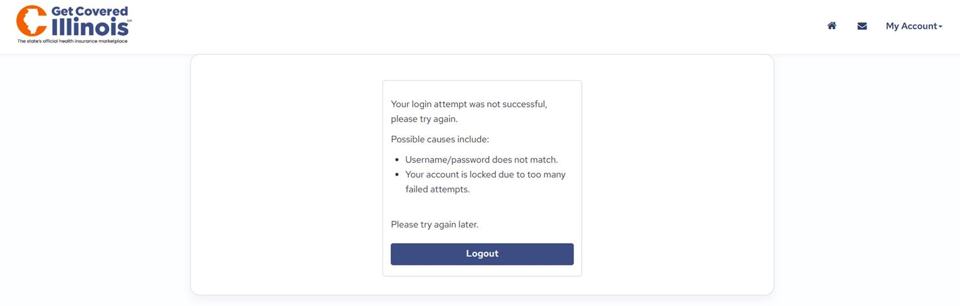
Broker Account Inactivity: IMPORTANT
Login credentials for Broker Portal accounts will be locked after 60 days of inactivity (i.e., not logging in) due to privacy and security reasons.
To unlock your account:
Call the Partner Support Line (1-866-349-7579) to verify your identity reactivate your Broker Portal account.
Update your Broker Portal password.
Log into your account regularly to prevent future lockouts.

Slide 8
Open Enrollment Timeline
December 19, 2025: Final date to complete certification requirements for Plan Year 2026.
December 31, 2025: Deadline to enroll for January 1, 2026, coverage (without an SEP).
January 15, 2026:
End of Open Enrollment.
Deadline to enroll for February 1, 2026, coverage (without an SEP).
After January 15, 2026: Enrollment requires a QLE/SEP.

Slide 9
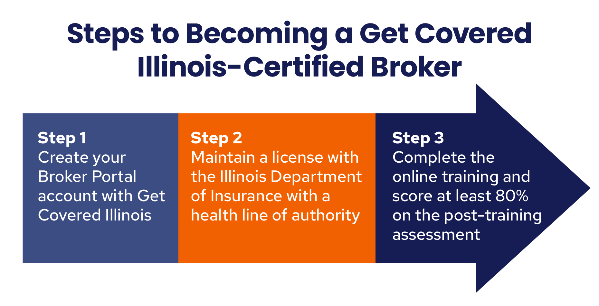

Slide 10
Broker Designations

Slide 11
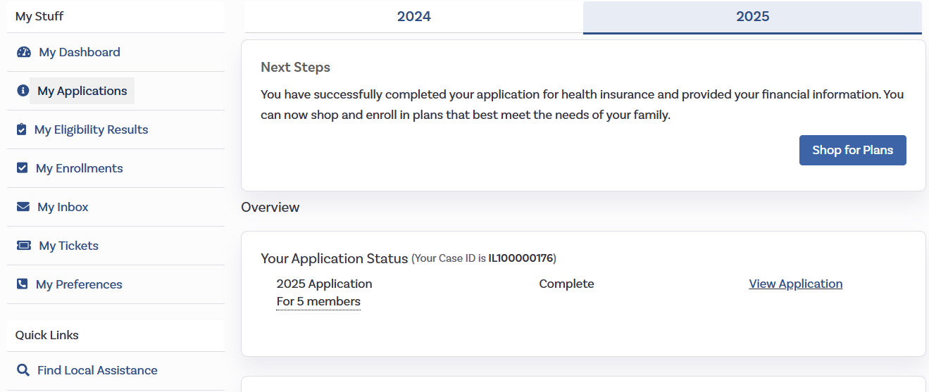
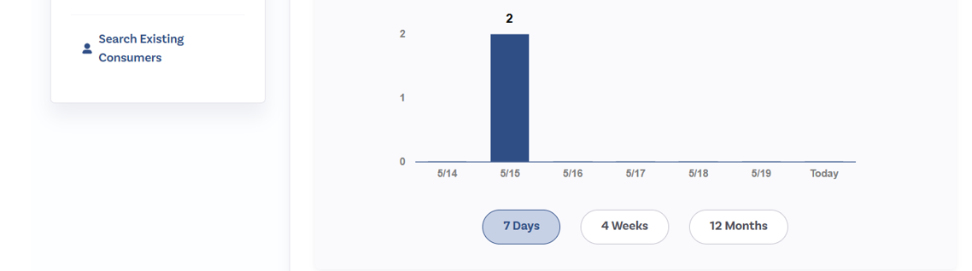
Customer Designations
(1) Find Local Assistance in Customer Account
Brokers can designate consumers in two ways:
(1) Consumers can select the broker from their account using the “Find Local Help” search tool.
(2) Brokers can use the “Search for Existing Customer” tool to designate themselves to an existing customer or create a new account if the customer does not have one.
Brokers can designate customers at any time of the year and at any point in the customer’s application or enrollment process.
(2) Search Existing Consumers in Broker Account

Slide 12
Detailed Walkthrough: Find Local Assistance Tool
Consumers can use to request a broker designation directly from their account. The high-level process is below:
Consumer selects “Find Local Assistance” within their account.
Consumer selects the broker that they want to work with and submits this request.
The broker receives this request on the “Pending Individuals” tab of their Broker Portal.
The broker accepts this request to become designated to the consumer.
NOTE: The slides are from a test environment and do not reflect Get Covered Illinois’ finalized language/content that will be displayed in the portal. All information shown is mock data (no real PII).

Slide 13
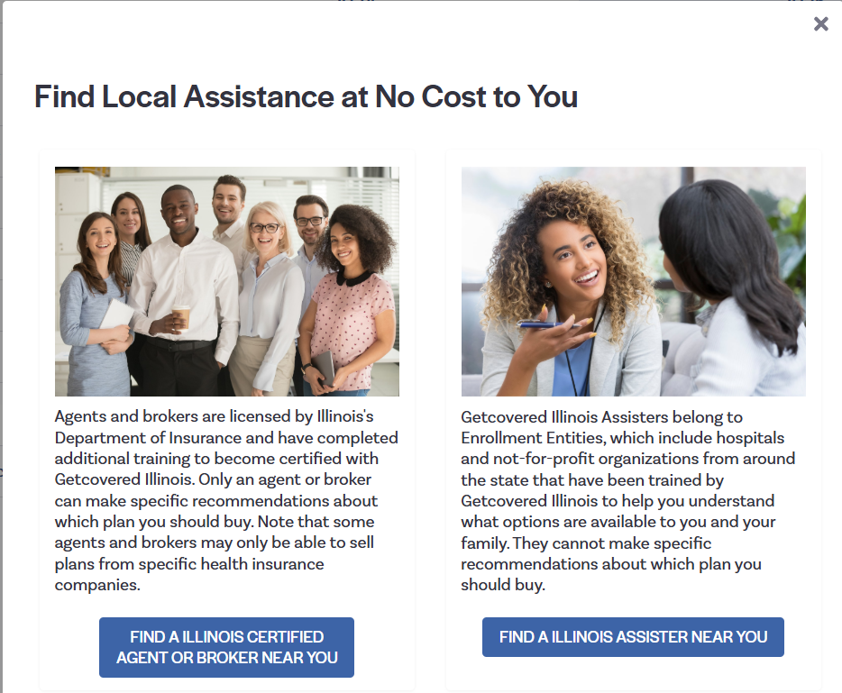
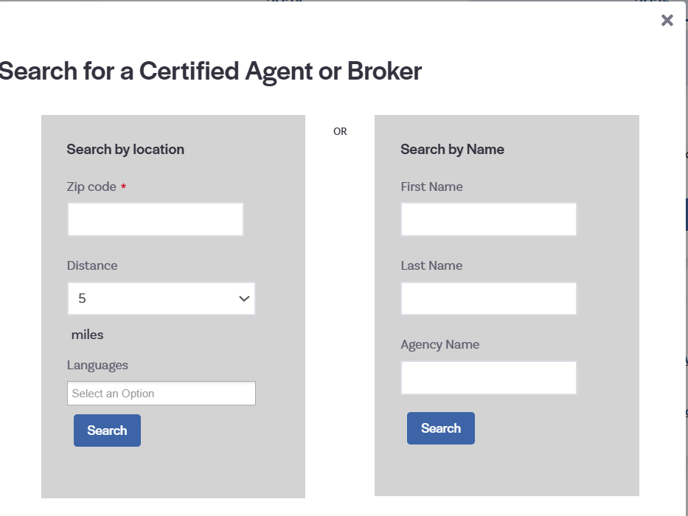
Detailed Walkthrough: Find Local Assistance Tool
Step 2: Consumers select “Find an Illinois Certified Agent or Broker Near You”*
Step 3: Consumers can input a Zip Code range, or the broker’s name if they know who they want to work with already.

Slide 14
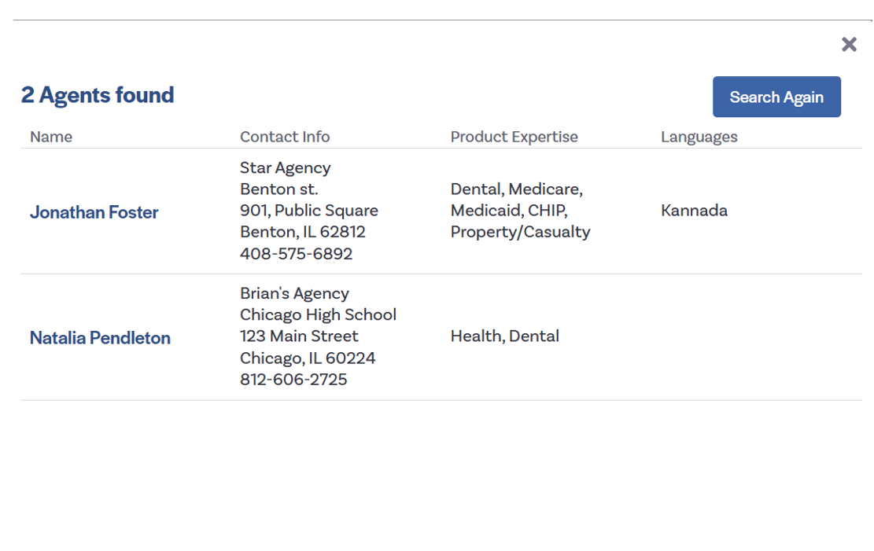
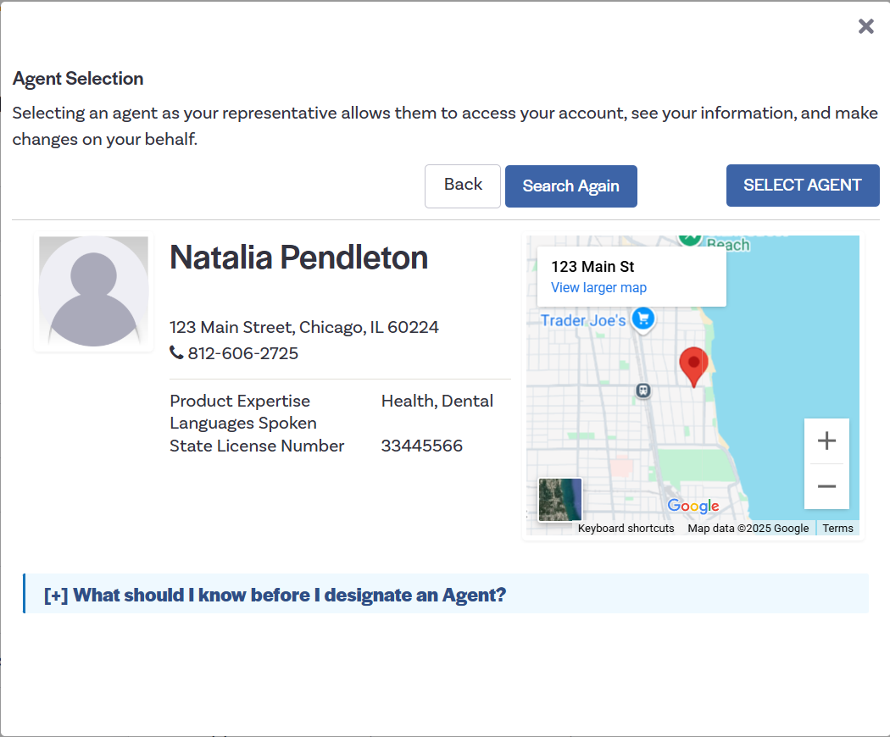
Detailed Walkthrough: Find Local Assistance Tool
Step 4: Consumers selects the name of the broker that they would like to work with.
Step 5: Consumers click “Select Agent” if they would like to proceed with this broker:

Slide 15
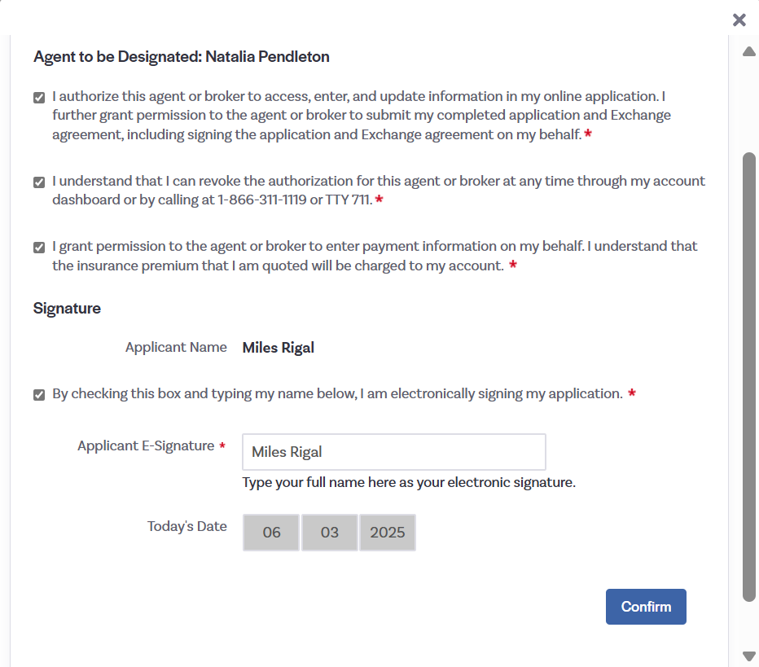
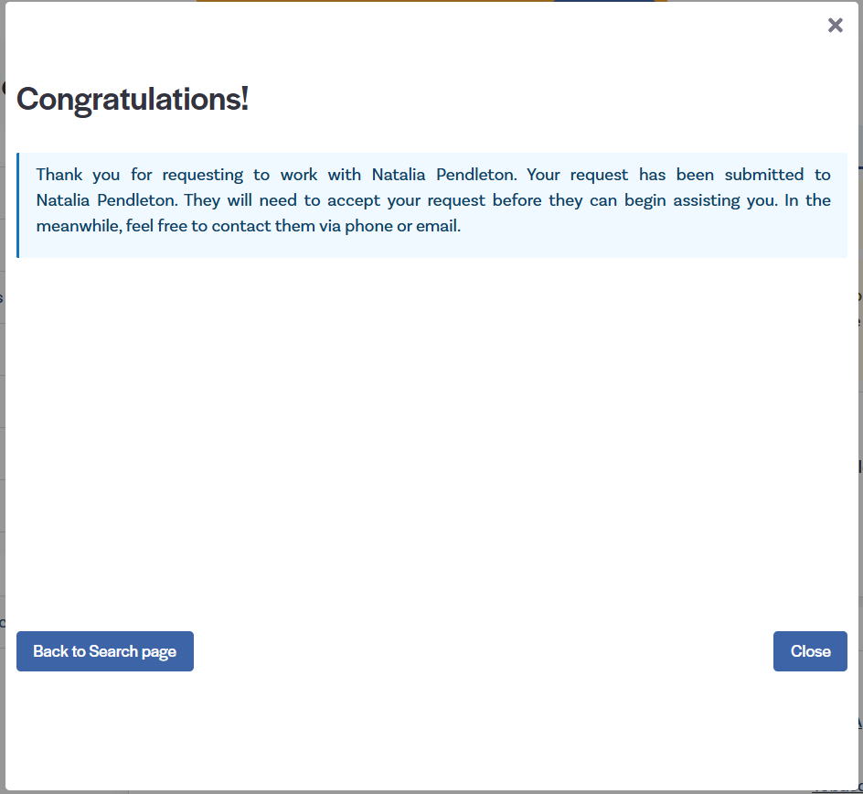
Detailed Walkthrough: Find Local Assistance Tool
Step 6: Consumers review the agreement and select “Confirm”.
Step 7: Consumers receive success screen informing them that their request was sent to the broker.

Slide 16
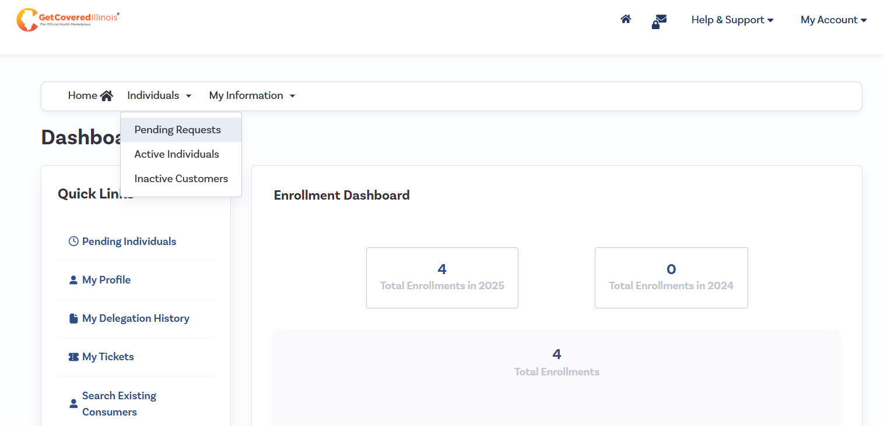
Detailed Walkthrough: Find Local Assistance Tool
Step 8: Broker navigates to “Pending” Individuals tab to view request.

Slide 17
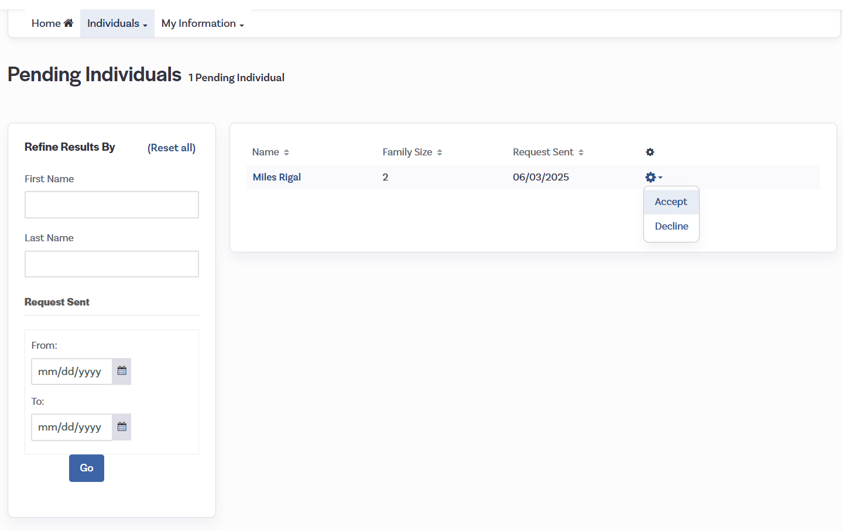
Detailed Walkthrough: Find Local Assistance Tool
Step 9: Broker selects “Accept” to designate the customer to their account.

Slide 18
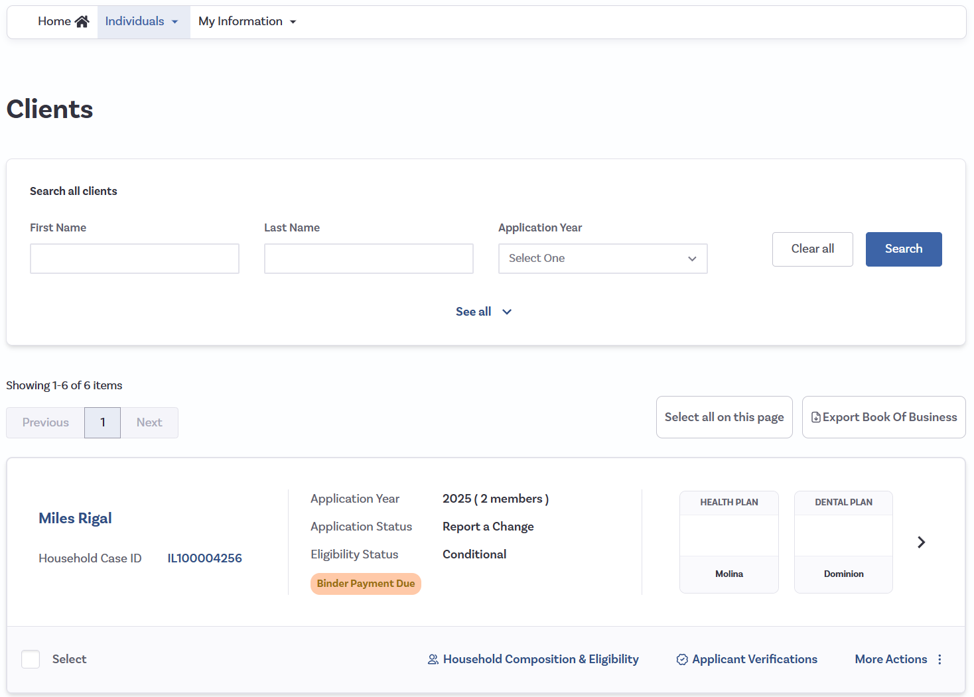
Detailed Walkthrough: Find Local Assistance Tool
Step 10: The customer is now in the broker’s Book of Business:

Slide 19
Provider Directory

Slide 20
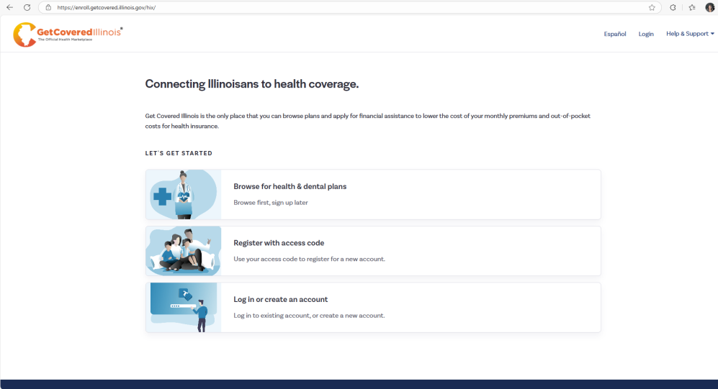
Provider Directory Search Instructions
Tips:
It is important to use the correct spelling and select the correct address of the provider or facility when completing your search.
If you hover over the name, you can also see the addresses to confirm before selecting.
To search for a hospital, please drop down the menu and choose Medical Facility. Also, select the facility name which includes the specialty “General Acute Care Hospital”.
Use the carrier website (link in plan details page) to cross validate provider search.
Step 1: Navigate to GetCoveredIllinois.gov and click on “Browse for health & dental plans”.

Slide 21
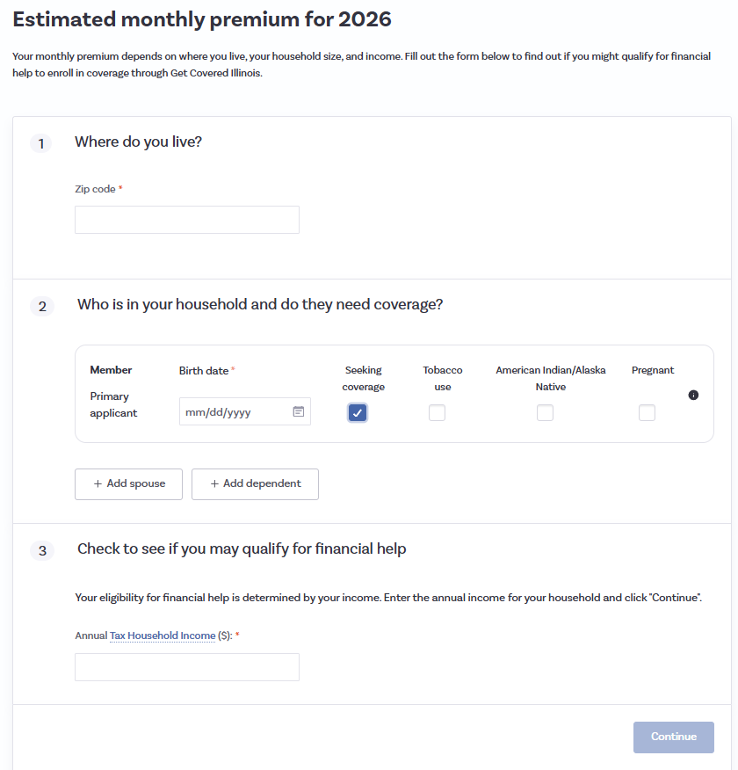
Next Steps
Step 2:
Enter demographic information and click “continue”.​

Slide 22
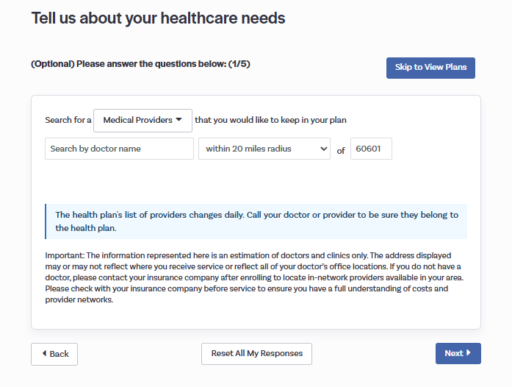


Healthcare Needs
Step 3: Click “Next”.

Slide 23
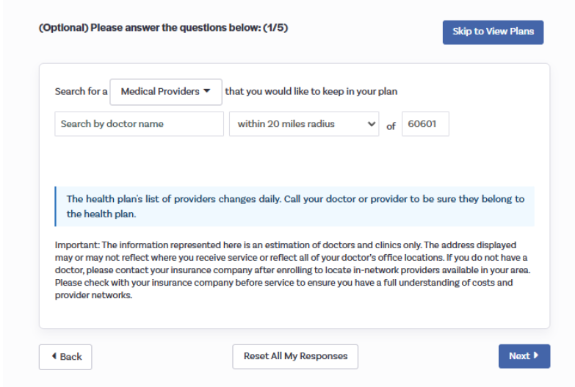
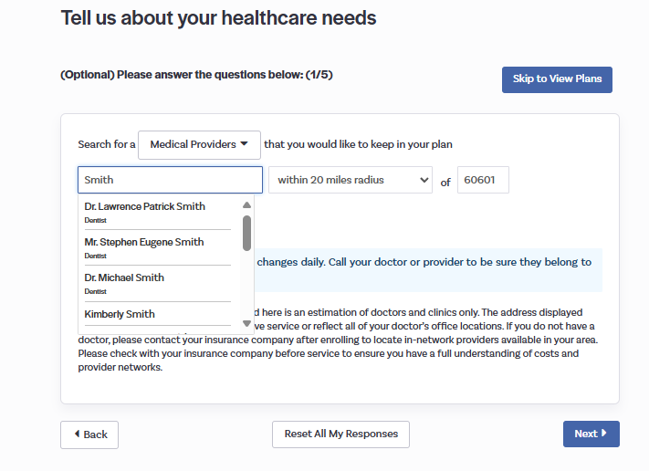
Additional Details
Step 5: Enter a provider or facility name and select the doctor or facility to review:
Step 4: Select “Medical Providers”, “Medical Facility”, or “Dental Providers” as appropriate:

Slide 24
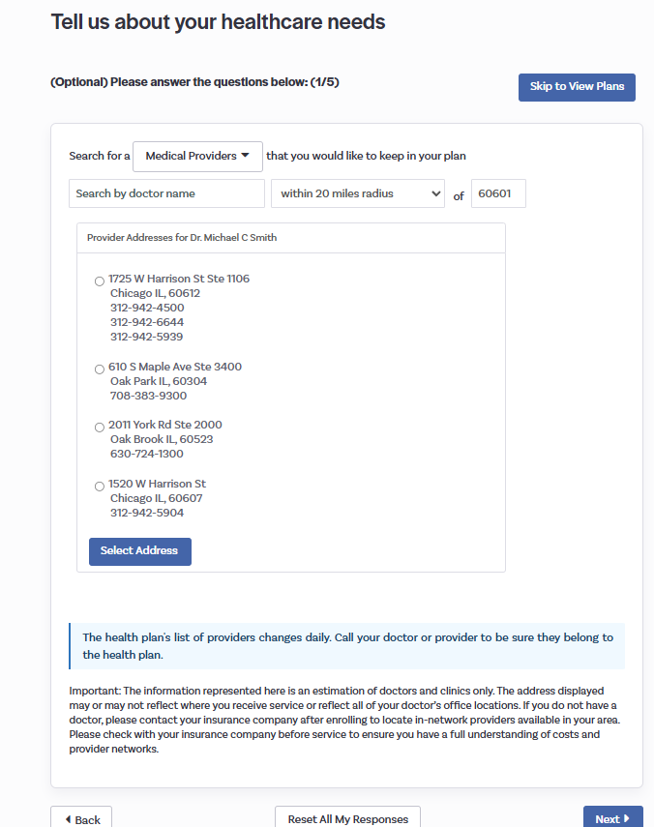
Confirm Address
Step 6: Select the address of the doctor or facility to review.
The provider directory for an insurer’s plan is incorrect on the Get Covered Illinois platform:
Provider directories on the Get Covered Illinois platform are updated regularly. For additional confirmation customers can reference the insurer website’s provider directory through the link in the plan details page or call the insurer directly.
Please remember that different providers/facilities in the same physical location (including hospitals) may have different provider network statuses.
If a you find an inaccurate entry on the Get Covered Illinois platform, you can take a screenshot of the entry and contact the broker support line 866-349-7579. Please include the provider’s 10-digit NPI (National Provider Identifier) with the screenshot as well as the name and address of the provider/facility.”

Slide 25
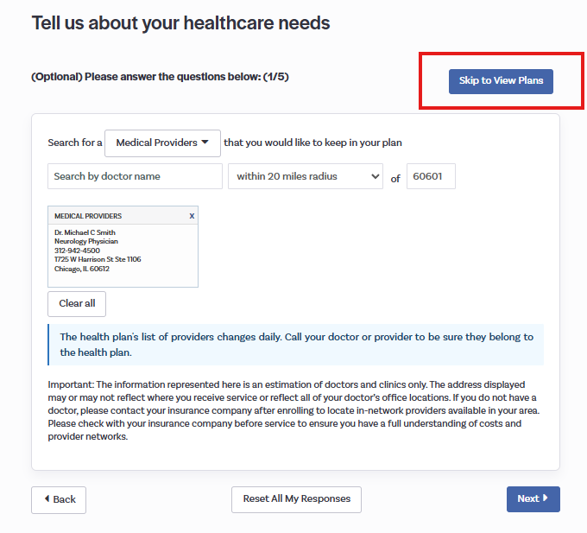
Step 7: After adding the providers to review, select “Skip to View Plans”.

Slide 26
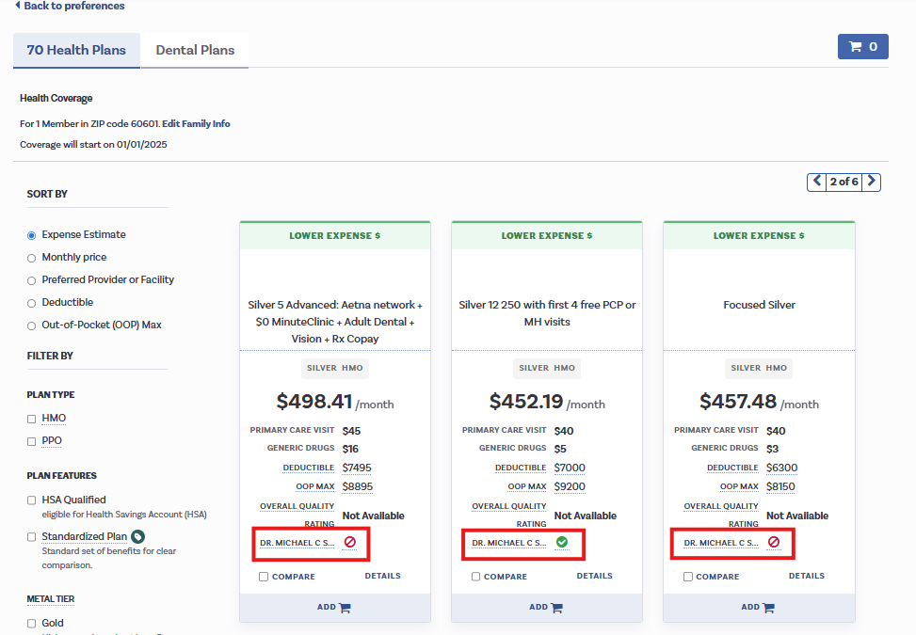
Final Steps
Step 8: Navigate to the plan tiles to verify if the provider is showing in or out of network.
Step 9: Select “Back to Preferences” to return to the Provider Search bar to repeat the process for other providers.

Slide 27
2026 Affordability Landscape

Slide 28
Coverage Costs are Increasing
Illinoisans, on average, will see a 78% increase in the monthly net premium of the plan they were renewed into.
2025 Statewide Average
$260
2026 Statewide Average
$464
 | 2025 Average | 2026 Average | Difference
Cook | $ 226.46 | $ 440.97 | 95%
DuPage | $ 317.48 | $ 544.43 | 71%
Lake | $ 350.72 | $ 514.34 | 47%
Will | $ 307.66 | $ 561.56 | 83%
Kane | $ 296.07 | $ 490.21 | 66%
Sangamon | $ 246.10 | $ 375.57 | 53%
Get Covered Illinois | Illinois Health Benefits Exchange Advisory Committee Meeting​ | December 2025
Notes:
Health Insurance premiums are increasing. Illinois households, on average, will see an estimated 78% increase in their premium if they remain in the same plan they were renewed into.
Please note, this data reflects ALL plans and includes subsidies, meaning it reflects net premiums – which is what the consumer actually pays. We have plans of various costs.

Slide 29
Silver Loading
Silver loading is a strategy newly implemented by Illinois this year that will increase advanced premium tax credits (APTC) for customers who qualify.
40-year-old single person in Cook county making $40,000 a year
Lowest Bronze | Lowest Silver | Lowest Gold
$157.09 | $280.82 | $ 227.86
Average net premiums for Silver plans increased by 142%.
Average net premiums for Bronze plans increased by 34%
Average net premiums for Gold plans decreased by 28%.
50-year-old couple in Shelby county making $60,000 a year
Lowest Bronze | Lowest Silver | Lowest Gold
$3.61 | $476.70 | $106
Since APTC is calculated based on the premium of the second-lowest cost Silver "benchmark" plan in a county, when the Silver plan rate increases in a county, so does APTC.
45-year-old couple with two children in Champaign county making $125,000 a year
Lowest Bronze | Lowest Silver | Lowest Gold
$6.46 | $847.18 | $7.20
APTC for qualified customers can be applied to enrollment in plans at any metal level.
Get Covered Illinois | Illinois Health Benefits Exchange Advisory Committee Meeting​ | December 2025
Notes:
There is some good news.
Because of a new strategy, silver loading, implemented by Illinois this year, some customers will have some pretty good plan options not available to them in previous years.
Since APTC is calculated based on the premium of the second-lowest cost Silver "benchmark" plan in a county, when the Silver plan rate increases in a county, so does APTC.
APTC can be applied to customer premiums regardless of metal level.
You can see in the scenarios on the slide that a 40-year-old single person in Cook county making $40,000 a year can enroll in the lowest-cost gold plan for about $50 less than the lowest silver
A 50-year-old couple in Shelby county making $60,000 a year can enroll in that gold for about $375 less than the silver
And a 45-year-old couple with two children in Champaign county making $125,000 a year can get the lowest-cost gold plan for about $840 less than the lowest-cost silver.
Unfortunately this does not help those over the 400% FPL, like we saw on the previous slide because they are no longer eligible for the subsidies.
Scenario 1: 40K (NOTE: approx 250% FPL)
Scenario 2: 60K: (NOTE: approx 275% FPL)
Scenario 3: 125K (NOTE: Approx 380% FPL)

Slide 30
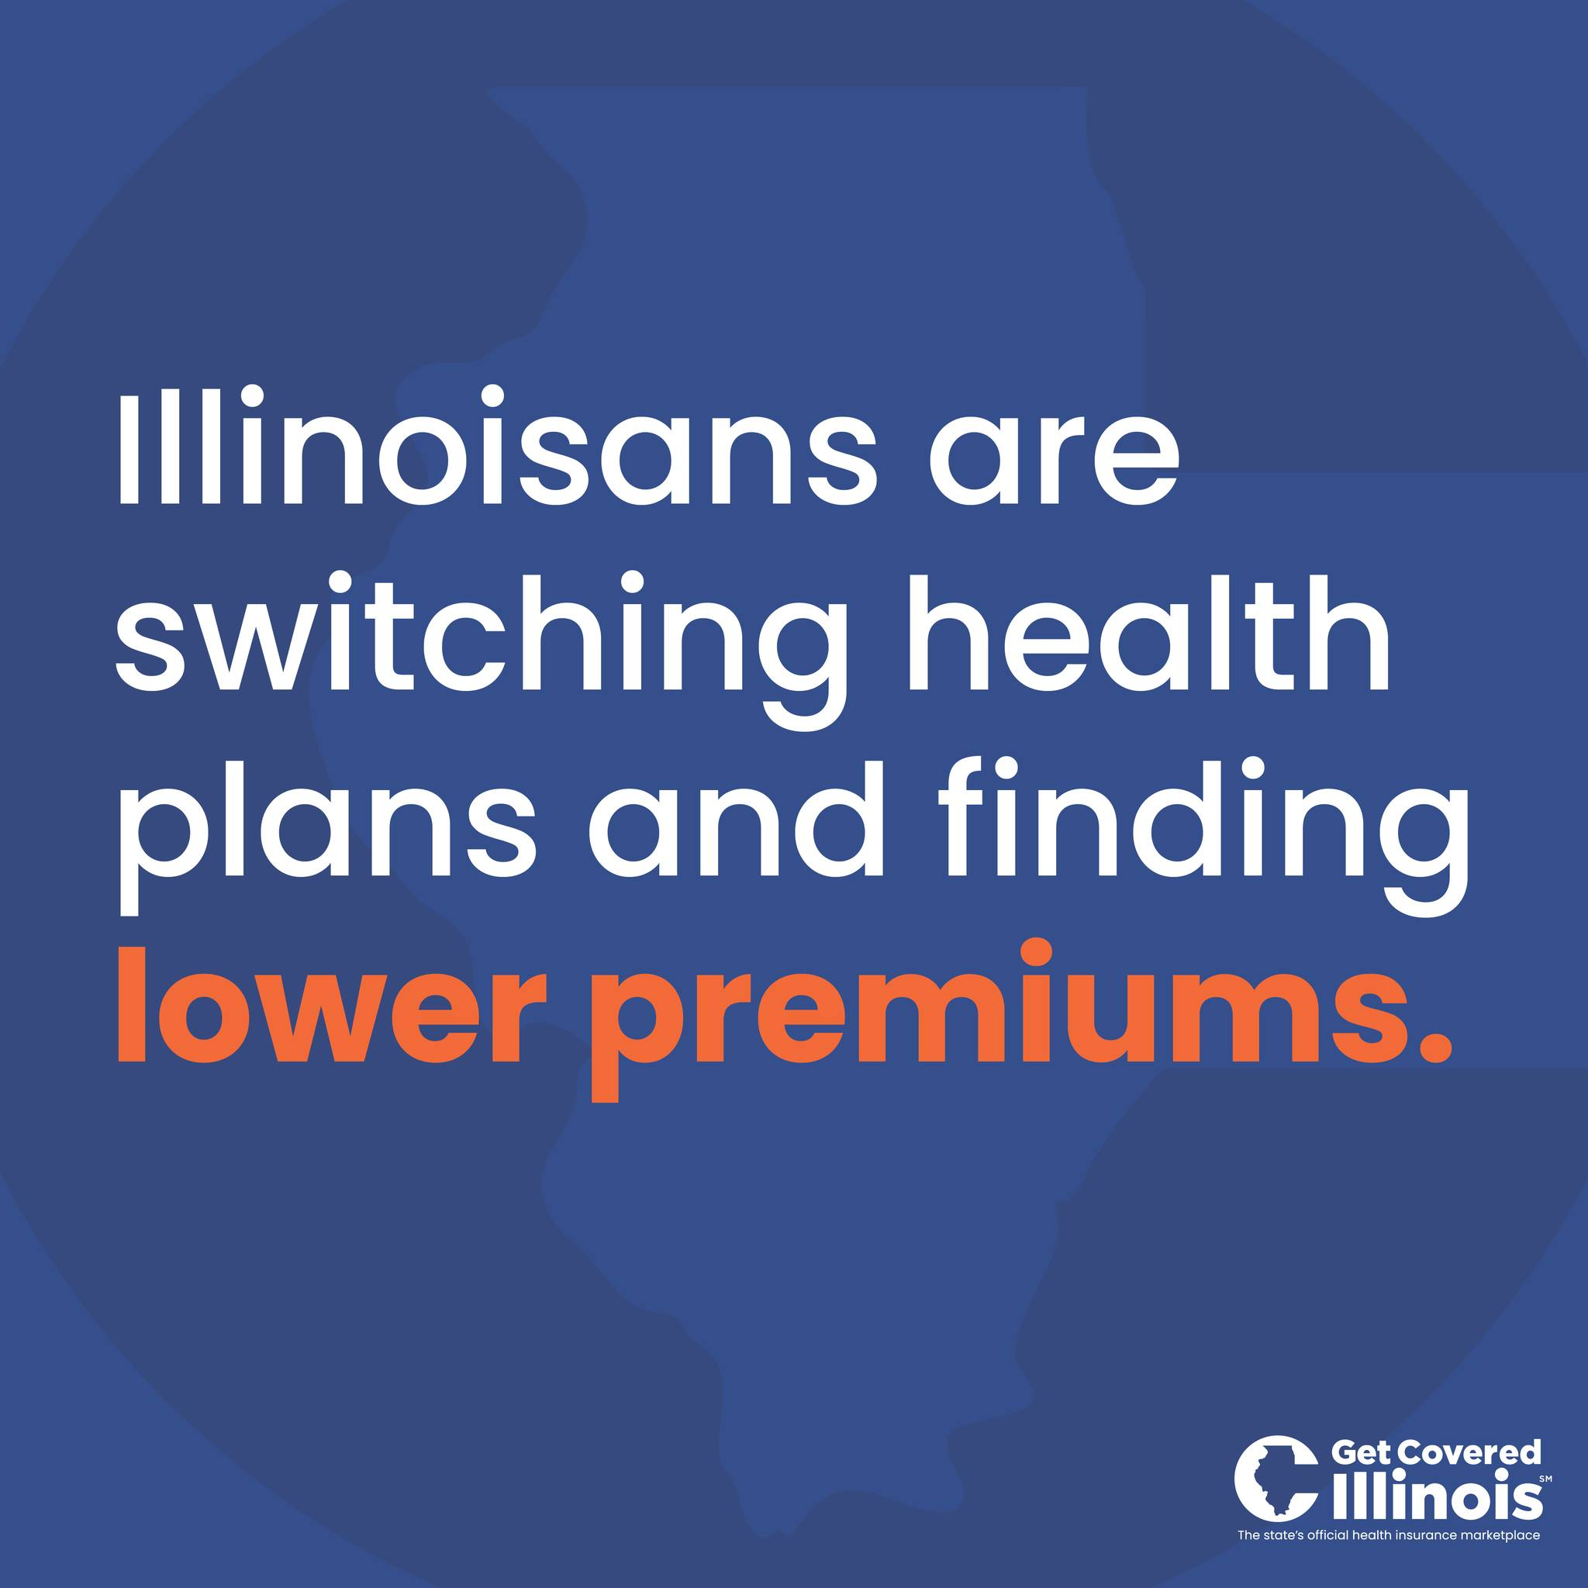
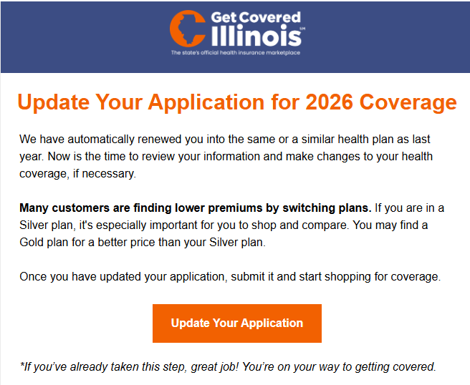
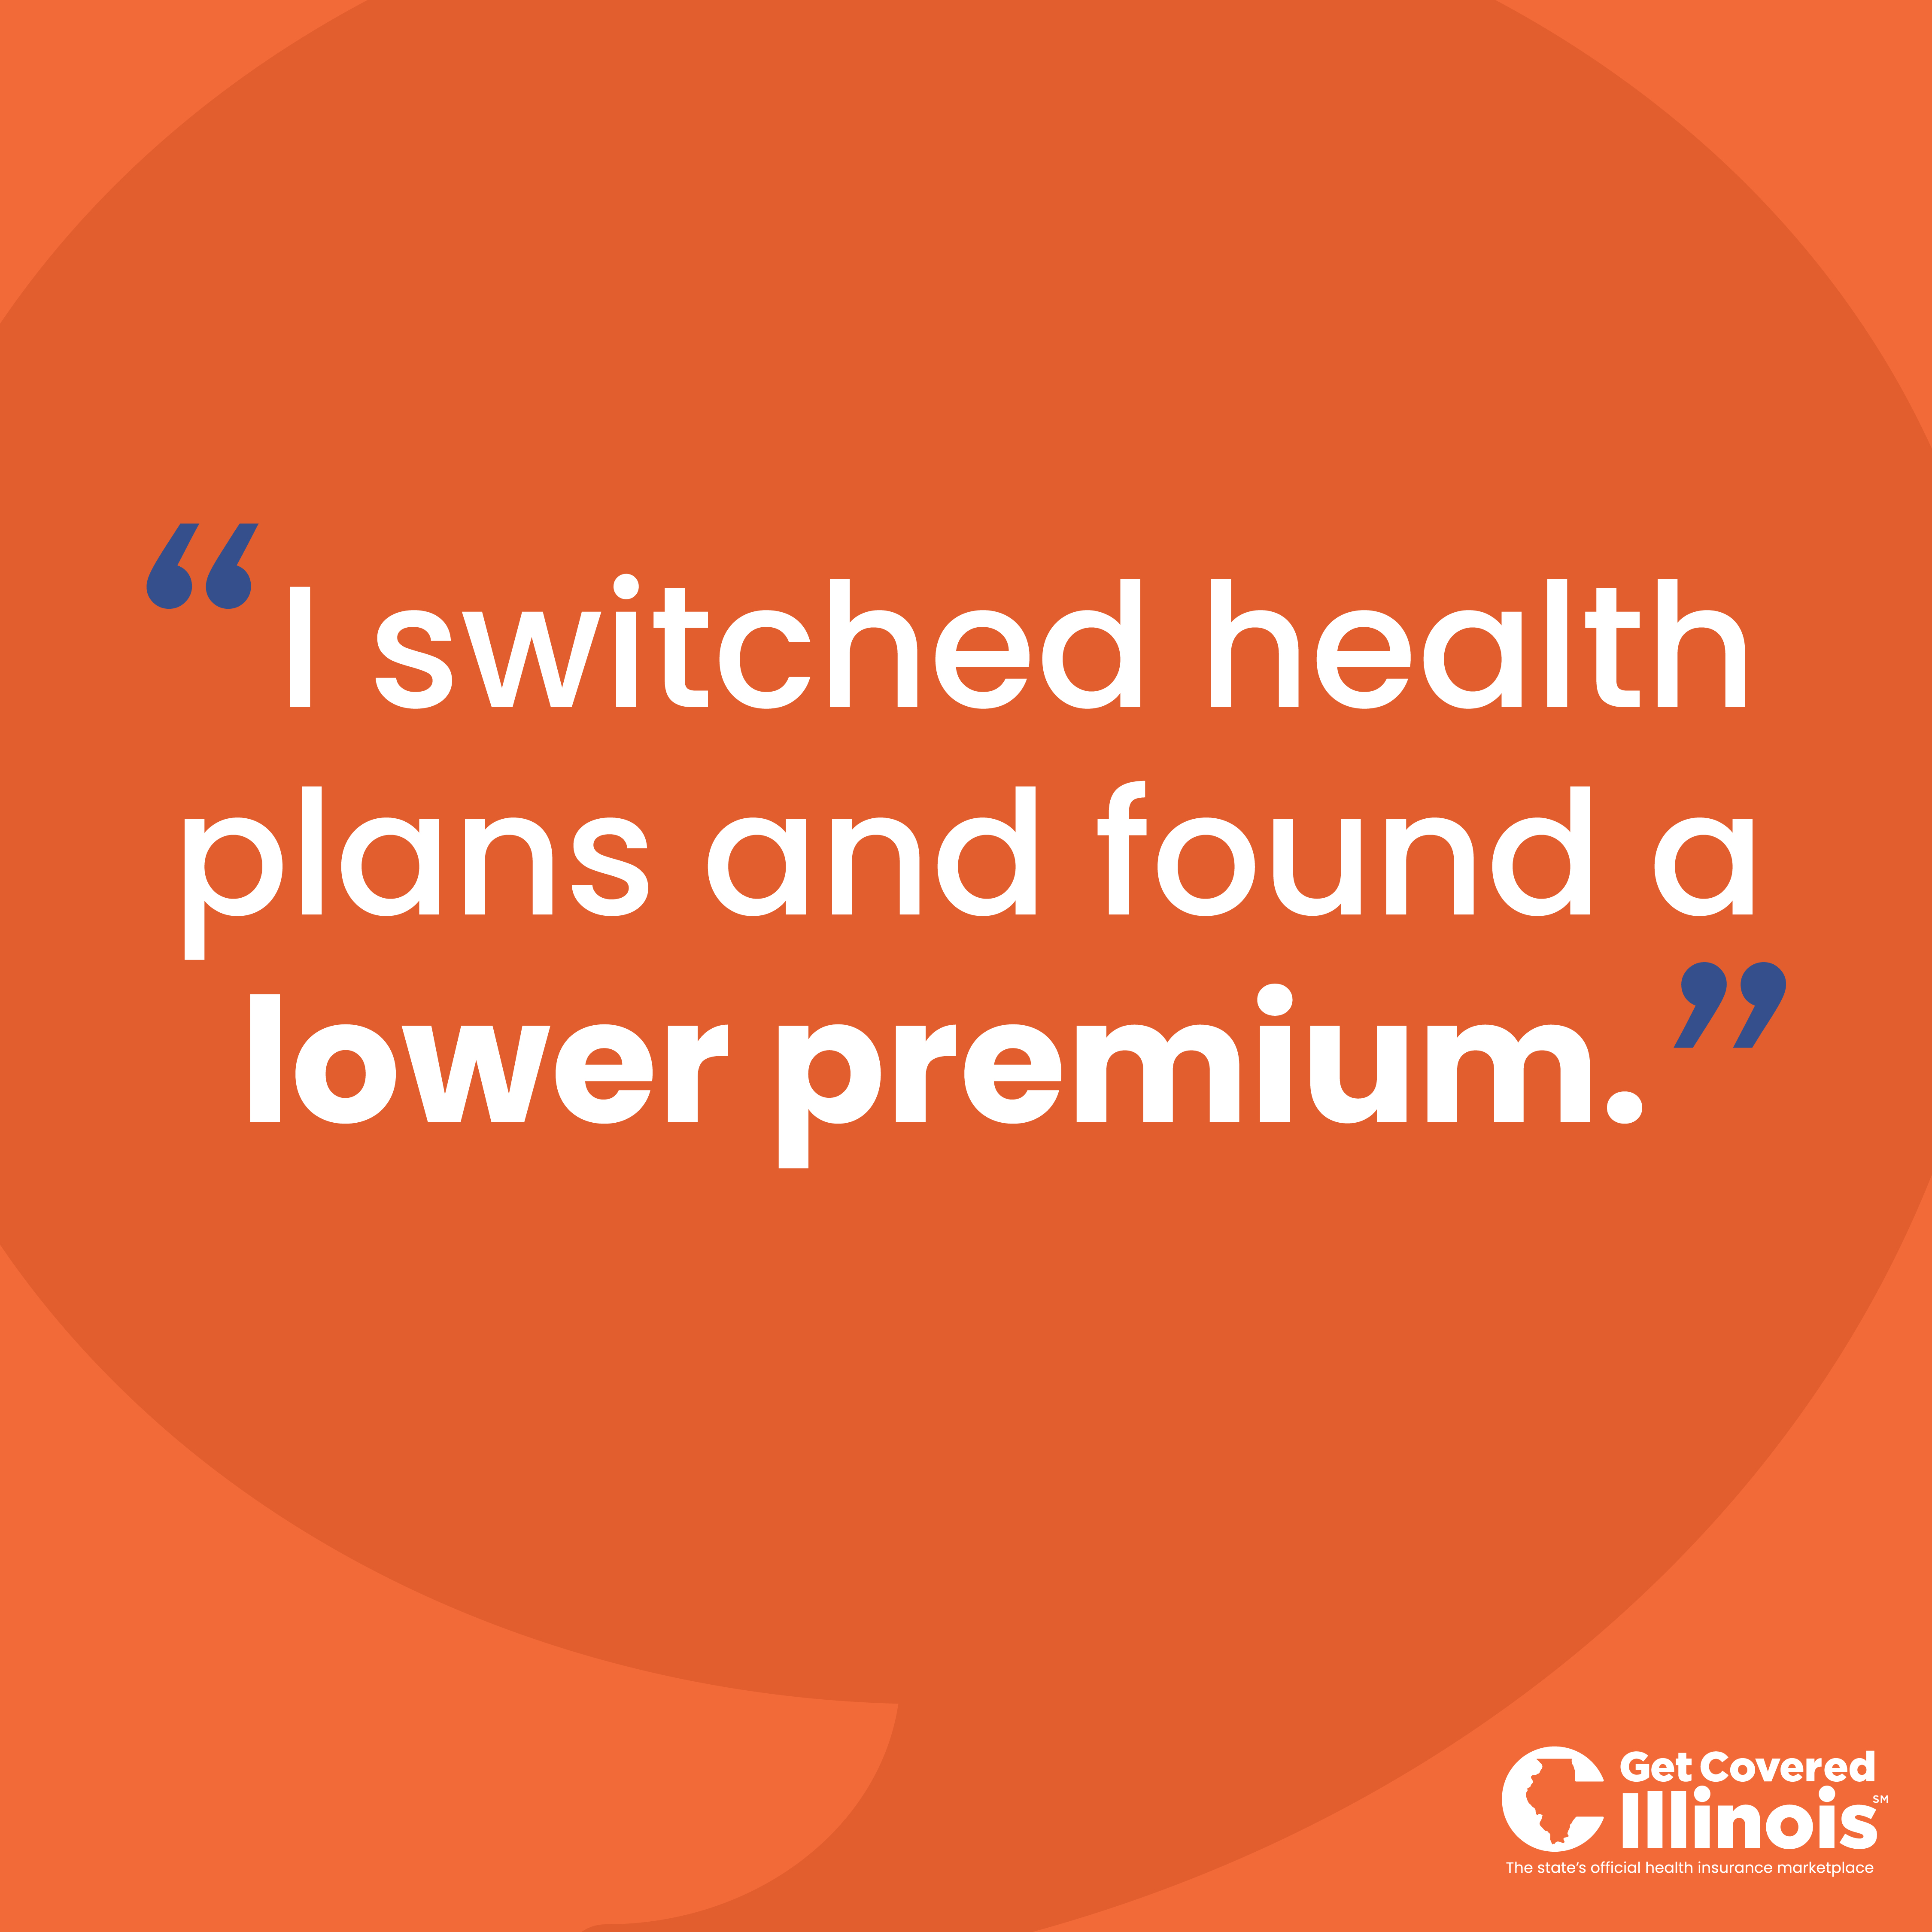
Silver Loading
Informational Campaign
An awareness campaign that encourages customers to shop for and compare plans to ensure they get the best plan and the best price for their health needs and budget.
Customer Outreach
Email blasts
Website
Social media campaign
Partner Outreach Tactics
Broker office hours
Navigator webinar
Updated marketing resources
Get Covered Illinois | Illinois Health Benefits Exchange Advisory Committee Meeting​ | December 2025
Notes:
We have quickly built an informational campaign to make Illinoisans (and specifically our migrated and renewed customers) aware that there may be lower premiums available to them.
All emails now include language letting customers know many customers are finding lower premiums by shopping and switching plans.
We included language on our website and have launched both an organic and paid social campaign.
Our partner outreach team is adding content about silver loading to their virtual broker office hours, navigator webinars, and our marketing team is building marketing resources for partners that encourages customers to actively shop and compare plans to make sure they are getting the best plan and price.

Slide 31
Recent Questions from Brokers

Slide 32
Binder Payments
What do I need to know about binder payments?
Binder payments are required to lock in coverage. Without the payment, customers will lose coverage.
Binder payments are made to the insurer. Customers can use the "Pay Now" link on their Get Covered Illinois Customer Portal to access the insurer's payment pages.
Payment deadlines vary across insurers. Deadlines may be as early as the coverage start date.
Grace periods do not apply to binder payments. If a binder payment deadline is missed, the coverage will be canceled, and customers will have to shop for coverage again (if they have an available shopping period).
Insurers who have received binder payments will notify Get Covered Illinois when the corresponding policy has been effectuated, but this notice is not required before the coverage start date or before effectuating (i.e., coverage can begin if the insurer received the binder payment AND before notifying Get Covered Illinois).

Slide 33
What Brokers Want to Know
Get Covered Illinois Customer Assistance Center
Hours (2026) | Outside of OEP | During OEP
Monday–Friday | 8am–6pm CT | 8am–8pm CT
Saturday | Closed | 8am–2pm CT
Sunday | Closed | Closed
See https://getcovered.illinois.gov/get-help for days with extended hours due to key deadlines, and holiday closures.
How do I access/get a new link to my broker account?
Can a broker create or work in a customer account?
How do I shop for plans, provide a quote, and enroll customers?
Do I get credit for an enrollment the call center has helped me with?
Why am I showing as suspended in the broker portal?
After completing my certification training what are the next steps?
What do I do if one of my customers is assigned to another broker?
Can I request information about another broker?
How do I search for a provider in the provider directory?
How do you calculate income for the eligibility application?
Will coverage be effective 1/1/2026 if uploaded documents are not verified by 12/15/2025?
What is the number for the partner support line?
Partner Support: 1-866-349-7579
Customer Support: 1-866-311-1119
What are the hours for the Customer Assistance Center?

Slide 34
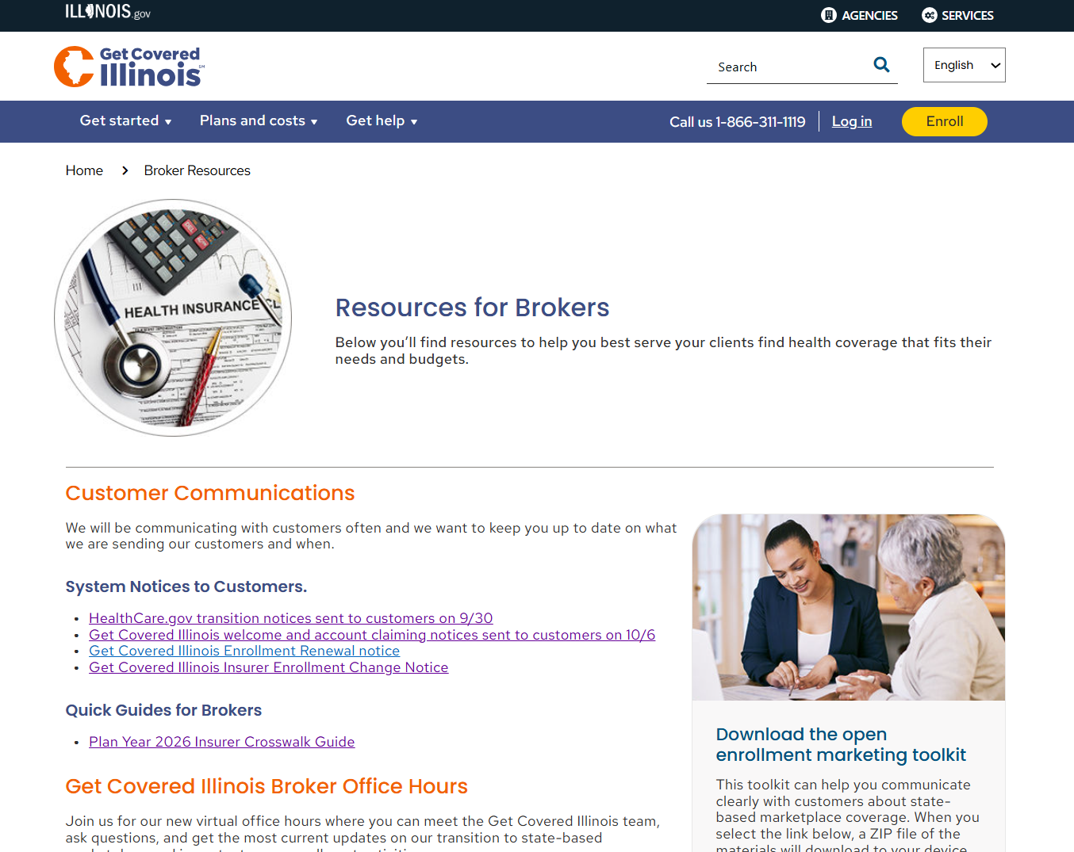
Broker Resources Web Page

Slide 35
Open Office Hour

Slide 36
Next Get Covered Illinois Broker Office Hour
Join us for our next office hour!
Thursday, January 8, 2026, 11:00 AM CT
Register here.
Broker Webinar Resources
Recordings of past webinars and office hours
Slide decks
FAQs
​
Please complete the survey that will pop up on your screen at the end of the webinar.

Slide 37
Thank You!

