Slide 1
Get Covered Illinois Broker Office Hour
Thursday, February 19, 2026
11:00 AM CT

Slide 2
Logistics
Phone lines are muted upon entry. ​
To submit comments or questions, click the icon with three dots at the bottom right of your screen, then select the “Q&A” option. ​
  Questions are encouraged!
We will address technical questions about the webinar and recording as they come in.
The slides and recording will soon be available on the Get Covered Illinois website!
Please complete the survey that will pop up on your screen after exiting the office hour.

Slide 3
Agenda
Important Reminders
Certification Updates
Special Enrollment Periods
Affordability Landscape
Did You Know?
Q&A Session

Slide 4
Important Reminders

Slide 5
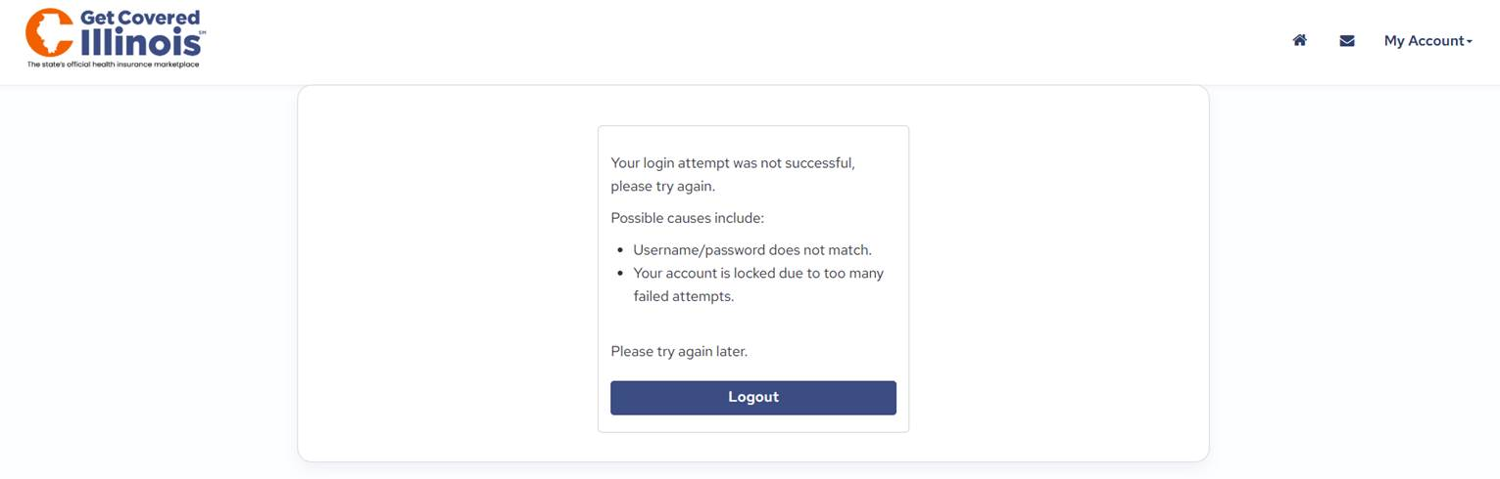
Broker Account Inactivity: IMPORTANT
Login credentials for Broker Portal accounts will be locked after 60 days of inactivity (i.e., not logging in) due to privacy and security reasons.
To unlock your account:
  Call the Get Covered Illinois Assister & Broker Support Team (1-866-349-7579) to verify your identity and reactivate your Broker Portal account.
  Update your Broker Portal password.
  Log into your account regularly to prevent future lockouts.

Slide 6
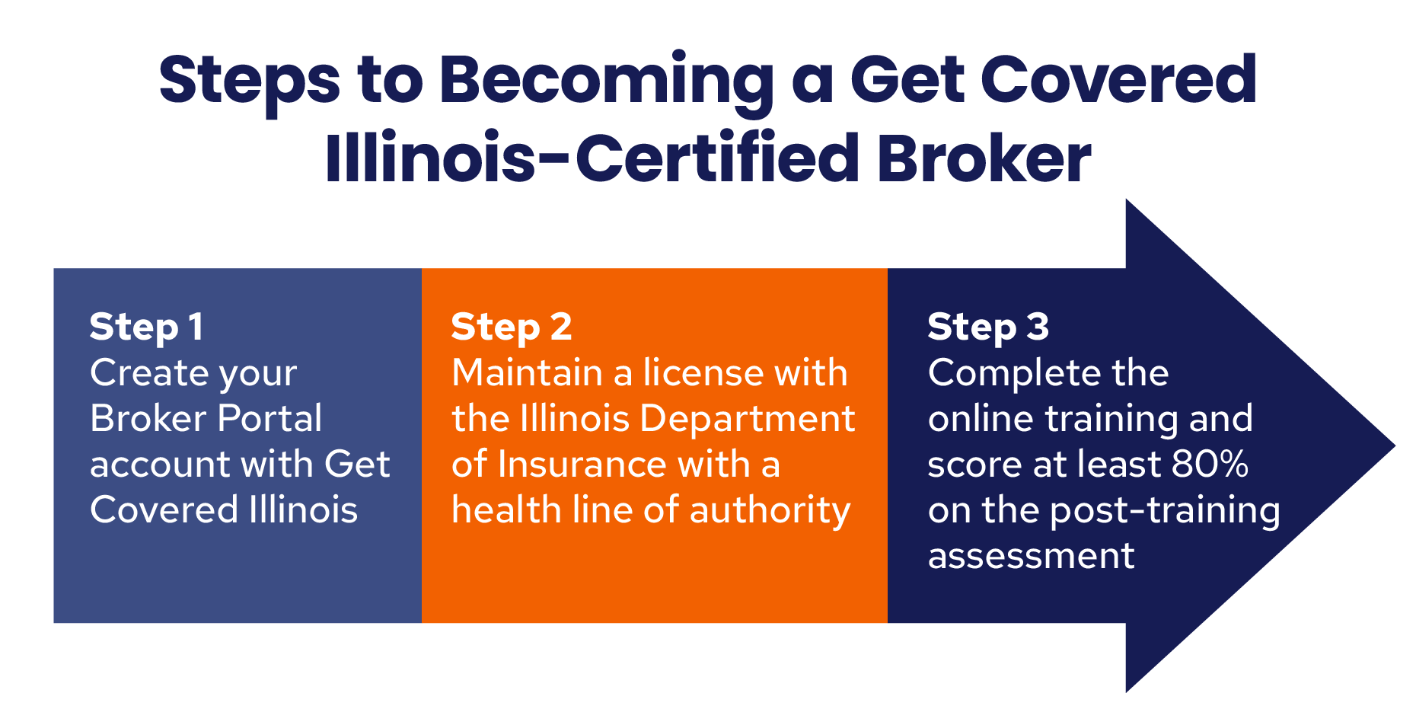

Slide 7
Certification Updates

Slide 8



Learning Management System Spring Cleaning
The Broker Certification Training for Plan Year 2026 on Get Covered Illinois will be temporarily unavailable beginning Monday, February 23, 2026. We are working to finish updates as quickly as possible. Watch the Get Covered Illinois website for additional information.
Please forgive our dust.

Slide 9
Special Enrollment Periods

Slide 10
Special Enrollment Periods
After January 31, SEPs require a QLE
  Qualifying life events (QLE) include four basic categories
Loss of health coverage including job-based coverage, student plans, Medicaid and All Kids, or turning 26 and losing coverage through a parent's plan
Household size changes including marriage and divorce, adoption and birth, and death
Change in residence including into Illinois from out of state and within Illinois to a different service area (county)
Other qualifying events including changes in income that affect coverage you qualify for, becoming a U.S. citizen, AmeriCorps members starting or ending service, and pregnancy
Limited-time marketplace transition year Special Enrollment Period
To qualify for this limited-time Special Enrollment Period, the enrollee must:
  Have been automatically renewed in a 2026 health plan through Get Covered Illinois, and
  Have not made an active plan selection or terminated/canceled their coverage during this past Open Enrollment Period, and
  Had not claimed their Get Covered Illinois account by February 1, 2026.
  Offered: February 1, 2026, through March 31, 2026.

Slide 11

Special Enrollment Periods
Illinois SEP: Pregnancy
Confirmation of pregnancy by a licensed provider is the triggering event
If not currently enrolled in a QHP, pregnant individual and unenrolled household members may be added to existing or new plans with a choice of effective date for the first of the month of the triggering event or the first of the month after plan selection
If currently enrolled in a QHP, pregnant individual and unenrolled household member may enroll in a new plan with an effective date of the first of the month after plan selection
May be eligible for Moms and Babies instead

Slide 12

Special Enrollment Periods
Illinois SEP: Easy Enrollment
  The Easy Enrollment SEP provides uninsured taxpayers an additional opportunity to explore coverage options when filing their Illinois 1040 state income tax return
Uninsured taxpayer indicates they would like health insurance benefit information on their state income tax return
Taxpayer receives and “Easy Enrollment” letter from Get Covered Illinois
Date of letter is the date of the triggering event
SEP not selectable; automatically opened via data transfer

Slide 13
Special Enrollment Periods
IMPORTANT!
Submit verification documentation ASAP
QLE documentation must be processed/verified before the customer/eligible household members can enroll in a QHP through the SEP
Earliest effective date is the first of the month after enrollment
Delays in submitting documentation can impact the customer coverage effective date

Slide 14
Special Enrollment Periods
IMPORTANT!
Submit verification documentation ASAP
  Example: Customer is losing employer coverage 7/31
Customer submits documentation of loss of coverage on 7/29
Documentation is processed/verified on 8/1
Customer enrolls in QHP on 8/1
Effective date of coverage is 9/1, creating a one-month gap in coverage

Slide 15
Special Enrollment Periods
Pre-reporting QLEs
  The following SEPs allow customers to report QLEs before the triggering event occurs:
Loss of Medicaid or All Kids (60 days before loss of coverage OR 90 days after loss of coverage)
Loss of employer or other health coverage (60 days before loss of coverage)
Loss of employer contribution to COBRA (60 days before triggering event)
Newly eligible for APTC/CSR due to changes in current employer plan (60 days before triggering event)
  Coverage begins the first of the month after the triggering event if a customer enrolls during the pre-reporting period. After the triggering event, coverage begins the first of the month after plan selection/enrollment.

Slide 16
2026 Affordability Landscape

Slide 17
Coverage Costs are Increasing
Illinoisans, on average, will see a 78% increase in the monthly net premium of the plan they were renewed into.
2025 Statewide Average
$260
2026 Statewide Average
$464
 | 2025 Average | 2026 Average | Difference
Cook | $ 226.46 | $ 440.97 | 95%
DuPage | $ 317.48 | $ 544.43 | 71%
Lake | $ 350.72 | $ 514.34 | 47%
Will | $ 307.66 | $ 561.56 | 83%
Kane | $ 296.07 | $ 490.21 | 66%
Sangamon | $ 246.10 | $ 375.57 | 53%
Get Covered Illinois | Illinois Health Benefits Exchange Advisory Committee Meeting​ | December 2025
Notes:
Health Insurance premiums are increasing. Illinois households, on average, will see an estimated 78% increase in their premium if they remain in the same plan they were renewed into.
Please note, this data reflects ALL plans and includes subsidies, meaning it reflects net premiums – which is what the consumer actually pays. We have plans of various costs.

Slide 18
Silver Loading
Silver loading is a strategy newly implemented by Illinois this year that will increase advanced premium tax credits (APTC) for customers who qualify.
40-year-old single person in Cook county making $40,000 a year
Lowest Bronze | Lowest Silver | Lowest Gold
$157.09 | $280.82 | $ 227.86
Average net premiums for Silver plans increased by 142%.
Average net premiums for Bronze plans increased by 34%
Average net premiums for Gold plans decreased by 28%.
50-year-old couple in Shelby county making $60,000 a year
Lowest Bronze | Lowest Silver | Lowest Gold
$3.61 | $476.70 | $106
Since APTC is calculated based on the premium of the second-lowest cost Silver "benchmark" plan in a county, when the Silver plan rate increases in a county, so does APTC.
45-year-old couple with two children in Champaign county making $125,000 a year
Lowest Bronze | Lowest Silver | Lowest Gold
$6.46 | $847.18 | $7.20
APTC for qualified customers can be applied to enrollment in plans at any metal level.
Get Covered Illinois | Illinois Health Benefits Exchange Advisory Committee Meeting​ | December 2025
Notes:
There is some good news.
Because of a new strategy, silver loading, implemented by Illinois this year, some customers will have some pretty good plan options not available to them in previous years.
Since APTC is calculated based on the premium of the second-lowest cost Silver "benchmark" plan in a county, when the Silver plan rate increases in a county, so does APTC.
APTC can be applied to customer premiums regardless of metal level.
You can see in the scenarios on the slide that a 40-year-old single person in Cook county making $40,000 a year can enroll in the lowest-cost gold plan for about $50 less than the lowest silver
A 50-year-old couple in Shelby county making $60,000 a year can enroll in that gold for about $375 less than the silver
And a 45-year-old couple with two children in Champaign county making $125,000 a year can get the lowest-cost gold plan for about $840 less than the lowest-cost silver.
Unfortunately this does not help those over the 400% FPL, like we saw on the previous slide because they are no longer eligible for the subsidies.
Scenario 1: 40K (NOTE: approx 250% FPL)
Scenario 2: 60K: (NOTE: approx 275% FPL)
Scenario 3: 125K (NOTE: Approx 380% FPL)

Slide 19
For Your Information (FYI for Brokers)

Slide 20
Did you know?
Brokers should have their clients verify accuracy on their 1095-A:
Carefully read instructions on the back
Make sure their coverage and household information is correct
Make sure the information about the Second Lowest Cost Silver Plan (SLCSP) is correct
If anything is incorrect, instruct clients to contact HealthCare.gov
Examples of Special Enrollment Periods offered through Get Covered Illinois:
Loss of minimal essential coverage like job-based coverage or Illinois Medicaid
Change in household size (e.g., birth of a child, marriage)
Change of residence to different service area
Change in income that makes them eligible/ineligible for financial assistance
Special circumstances (enrollment errors or provider violations)
Other qualifying events (e.g., pregnancy, spousal abandonment, requesting health coverage on their Illinois 1040 state income tax return)

Slide 21
Customer Assistance Center Hours
Days | Hours
Monday–Friday | 8 am–6 pm
Saturday and Sunday | CLOSED
See https://getcovered.illinois.gov/get-help for days with extended hours due to key deadlines, and holiday closures.

Slide 22
Open Office Hour

Slide 23
Next Get Covered Illinois Broker Webinar
Join us for our next webinar!
Thursday, March 19, 2026, 11:00 AM CT
Register here.
Broker Webinar Resources
Recordings of past webinars and office hours
Slide decks
FAQs
​
Please complete the survey that will pop up on your screen at the end of the webinar.

Slide 24
Thank You!

